Slide 1
Work on Efficient Computer Vision Methods in FIFA 23
6.506 Final Presentation
Ian Gatlin
Work on Efficient Computer Vision Methods in FIFA 23
May 14th, 2024
Demo Video: https://github.com/ijga/FIFACoachBot/blob/main/demo.mov
Github Repo: https://github.com/ijga/FIFACoachBot
Notes:
Hi everyone, today im going to discuss my work on efficient computer vision methods

Slide 2
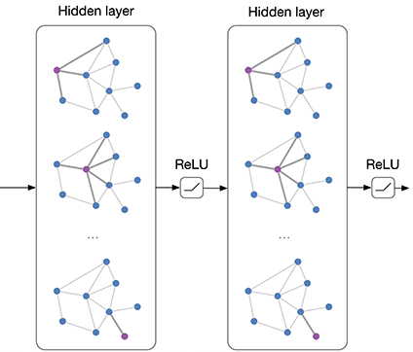
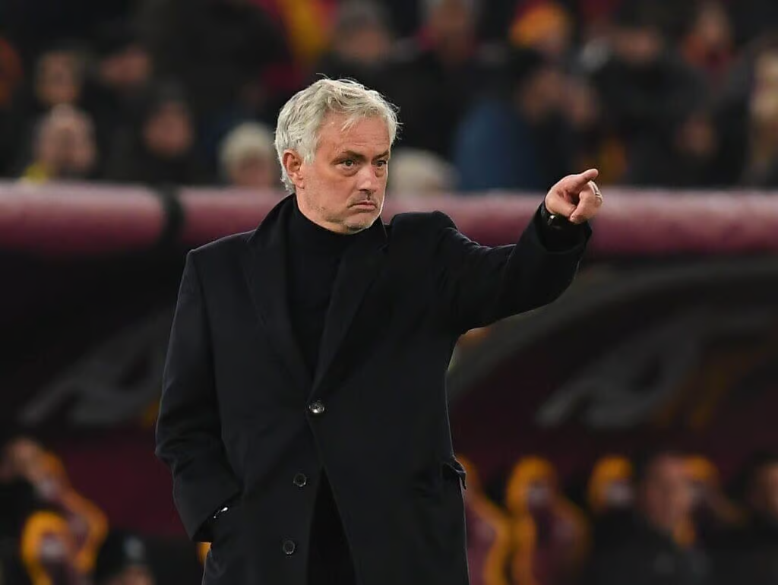
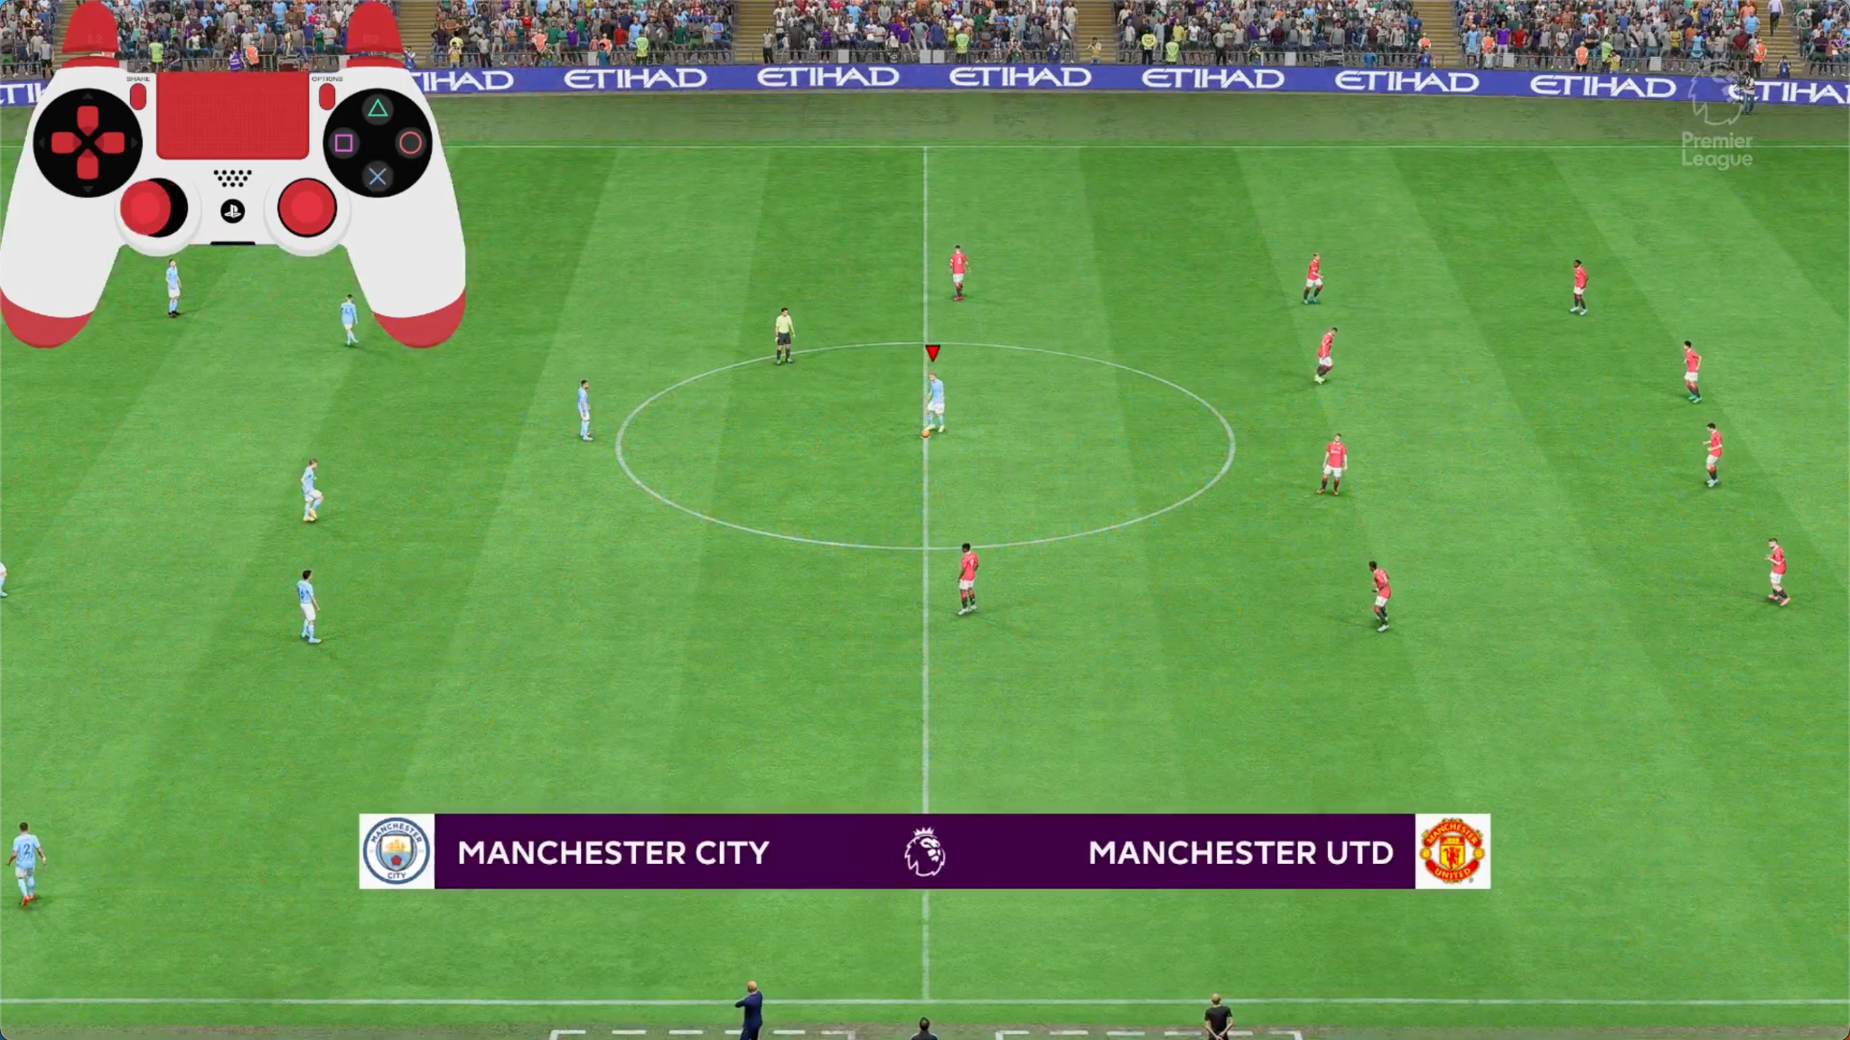
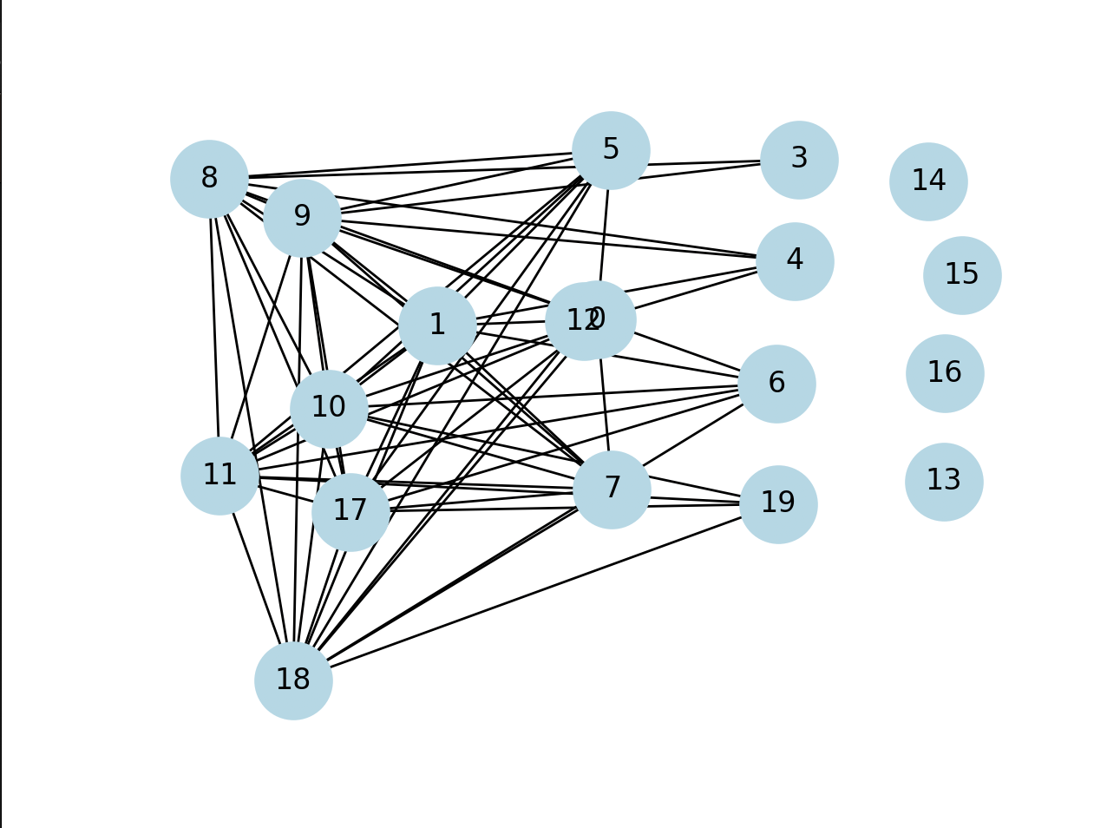
Overview of Project
Goal
Challenges
Quickly create high quality graph representations of soccer matches
Create a ML coaching model that gives instant coaching based on the state of the game
Finding small objects, specifically the ball
Personal laptops have slower hardware compared to the state of the art systems
Notes:
2020 mac book pro with M1 chip, 8 gigabytes of RAM
This would fulfill the need of coaching for amateur fifa gamers. FIFA has a big pro scene and the best players have coaches. To get better, it would be useful to have a coach that could give you feedback.

Slide 3
Three Interesting Problems
Consistent Representations with Different Camera Angles
Training a Quality CV Model
Applying CV Model to Footage
Used bounding box object detection
100 images with little variability
Tiling frames and processing them sequentially and in parallel
No downscaling of frames
A lot of image processing to determine angle from fixed camera
Discuss other work
Notes:
Go quickly

Slide 4
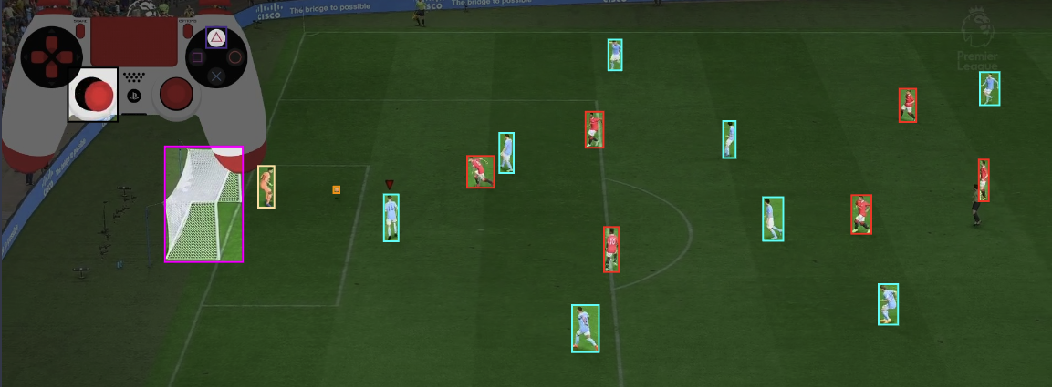
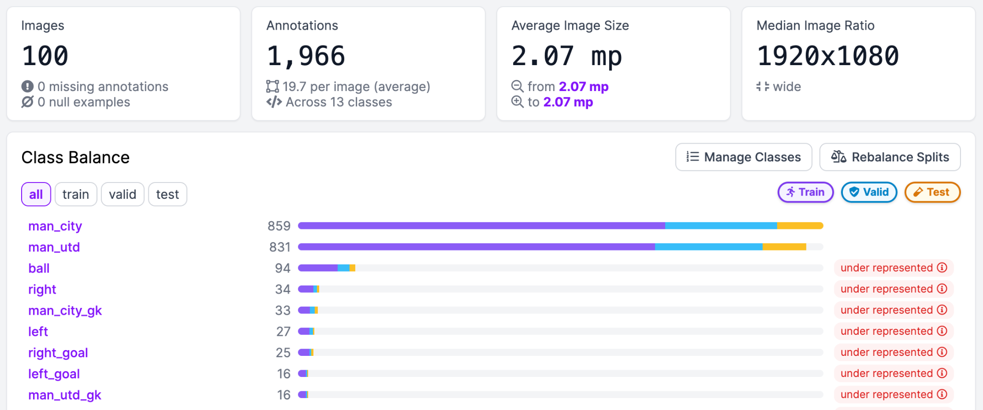
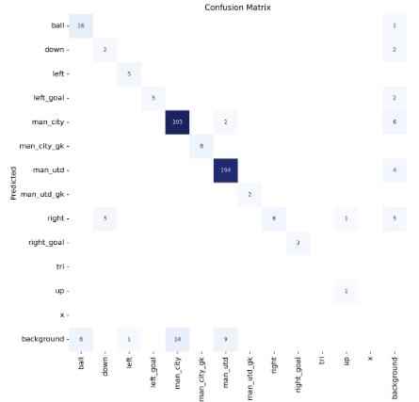
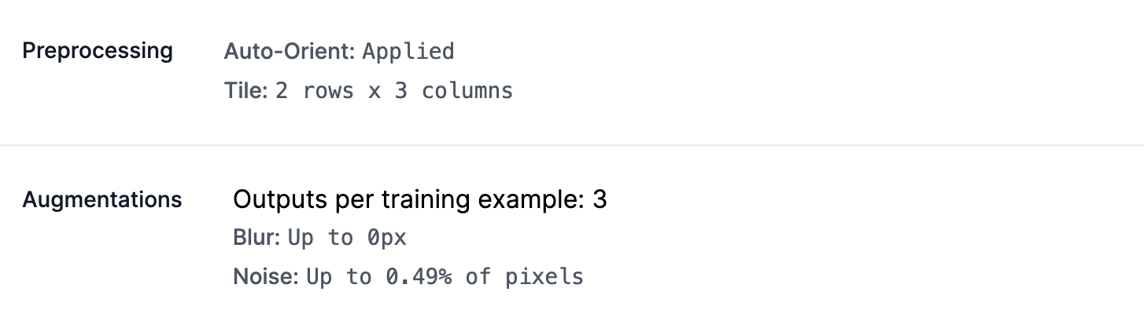
CV Model Generation with Yolov8 and Roboflow
Labeled 100 images
Attempted to encode controller input
Tiled Images 2 rows x 3 columns [1]
1440 Total Images
200 Epochs
Notes:
Labeled 100 images of the game
Did some research and tiling inputs into the model was a good way for the model to better identify smaller objects.
After experimenting on a bunch of different tiling variations by training them and testing them manually, went with 2 rows and 3 columns. Each tile is treated like a separate photo.
After 200 epochs of training, we see that is does a solid job of detecting the ball which is in the top left of the matrix. It gets 16/23, does better in practice
Did this on google clobal

Slide 5
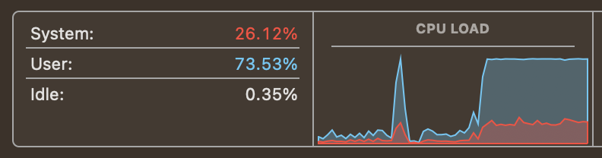
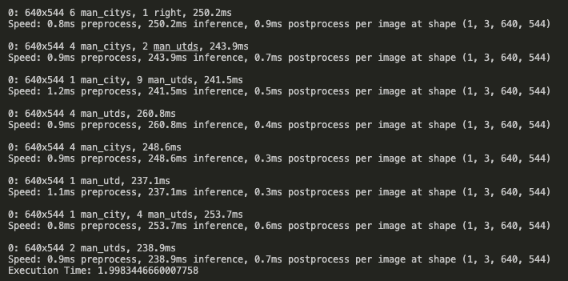

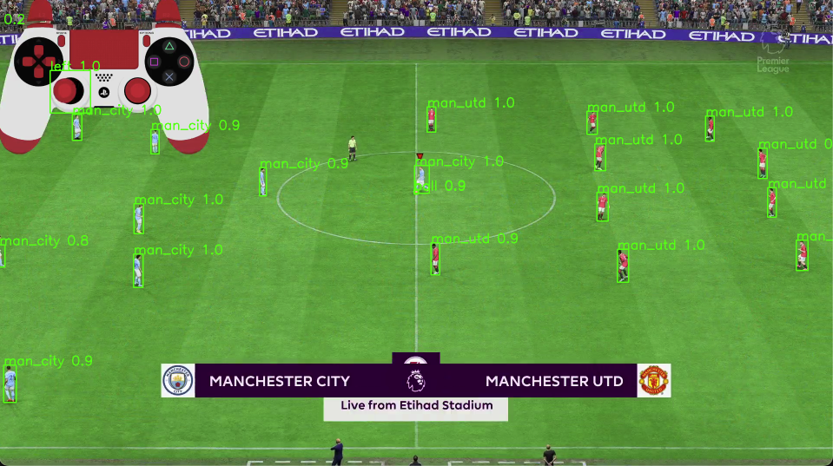
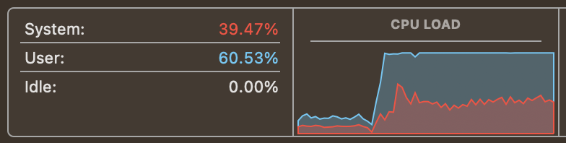
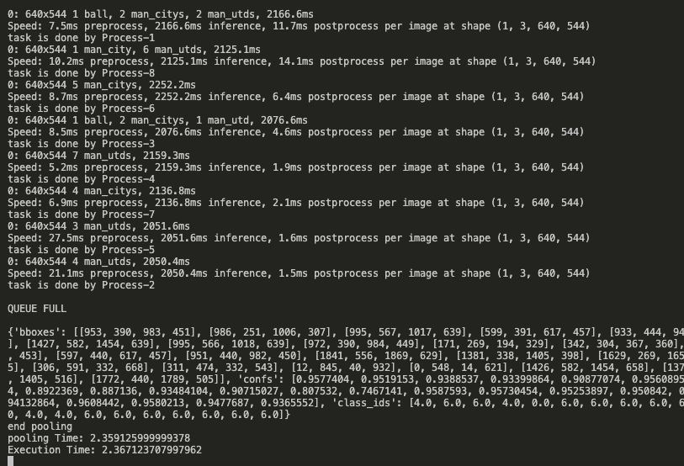


Applying CV Model to Footage
Tiling [2]
Wall-clock time to complete object detection on a tile
Serial
Library implemented in parallel?
Parallel [3]
Memory sharing problems (1MB)
Process management overhead
Notes:
When you use yolo models to find objects on an image, it automatically downsamples, which makes it hard to find small object. A way to still see objects when downsampling is to tile the image into smaller pieces that you run the model over. So we run it over all the red squares, so eight times, with a little overlap, and then combine everything. We can do each of the tiles in parallel or serially.
I thought that since object detection took on the order of magnitude of hundreds of milliseconds, as seen in the bottom, parallelising it would give speedups from 4-8x.
Talk about experimental results
Talk about cpu load on serial, makes me think its parallelized under the hood since CPU load is maxed. But its weird bc in documentation it says to use multiprocessing could help speed it up. I think i would have to look at the actual implementation in the library.
The inference time also makes me think this, because it has 8 cores working together on a single tile in serial using the C implementation.
Each tile is 1mb and i have to transfer it manually to each process which takes some time and as we can see CPU is working a little more on management than in the serial implementation. Serial is faster.

Slide 6
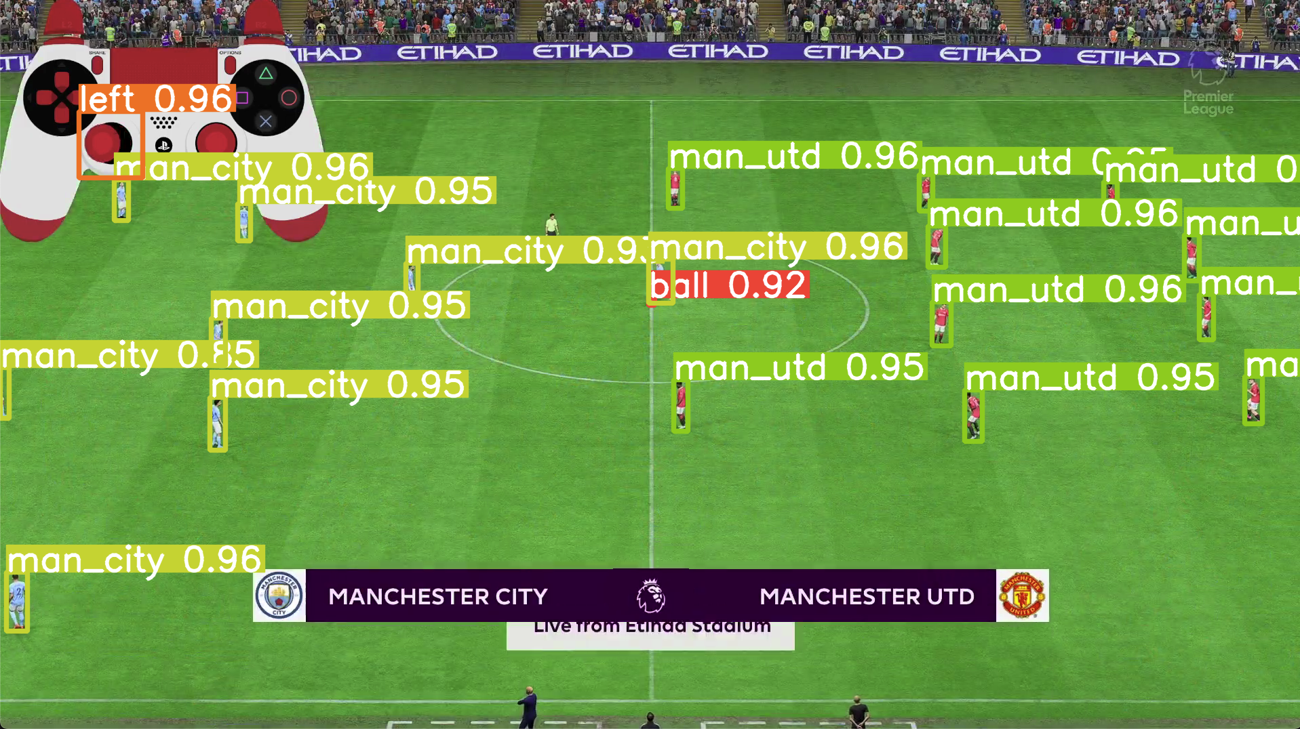
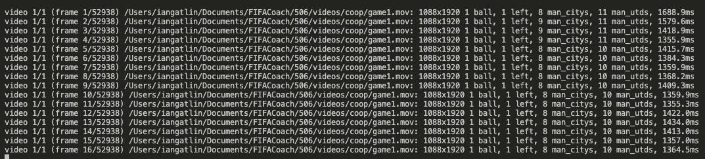

Applying CV Model to Footage
No downscaling
Manually set image size to not downscale (1080p) when running object detection
Honestly works the best
Kinda boring though

Slide 7
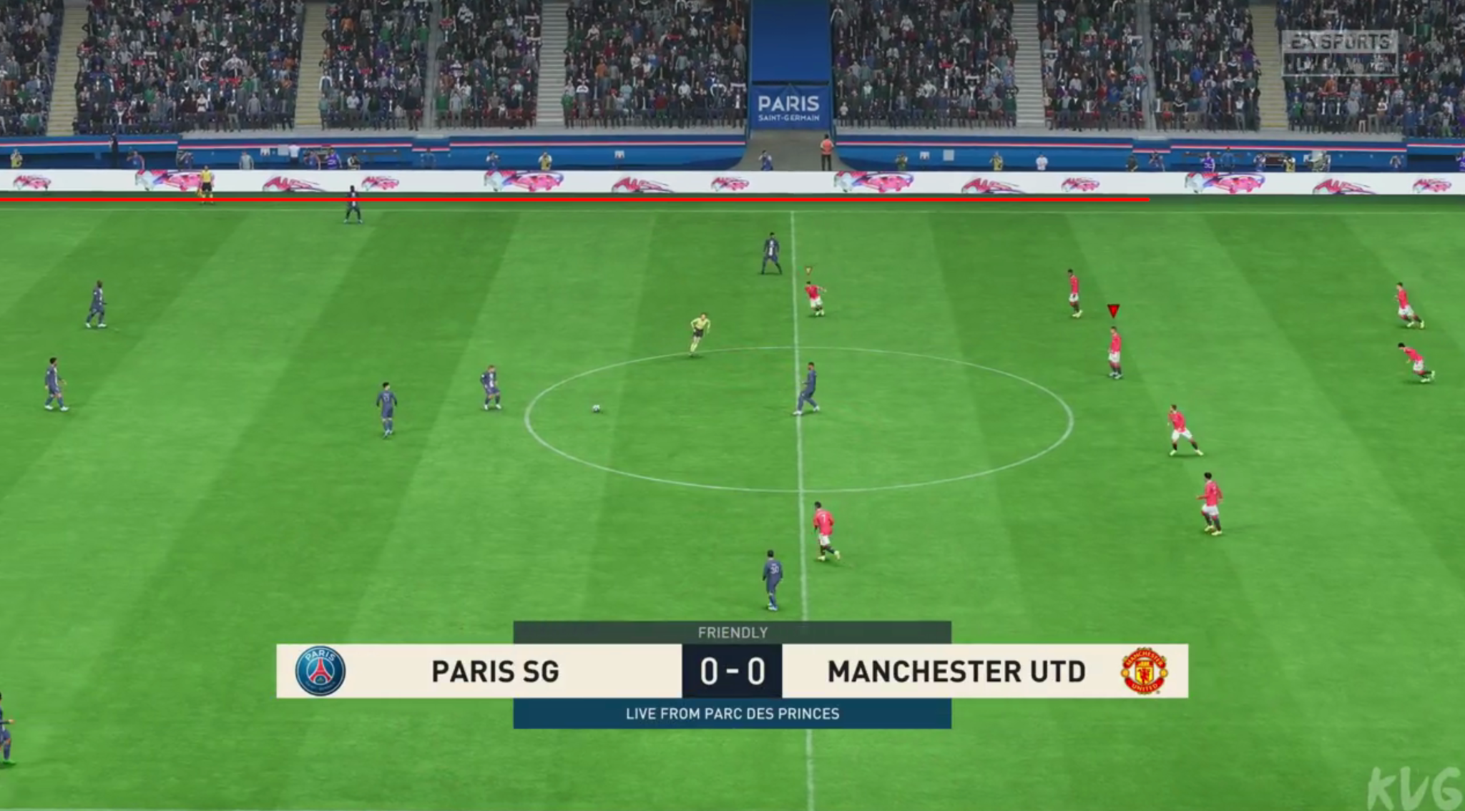
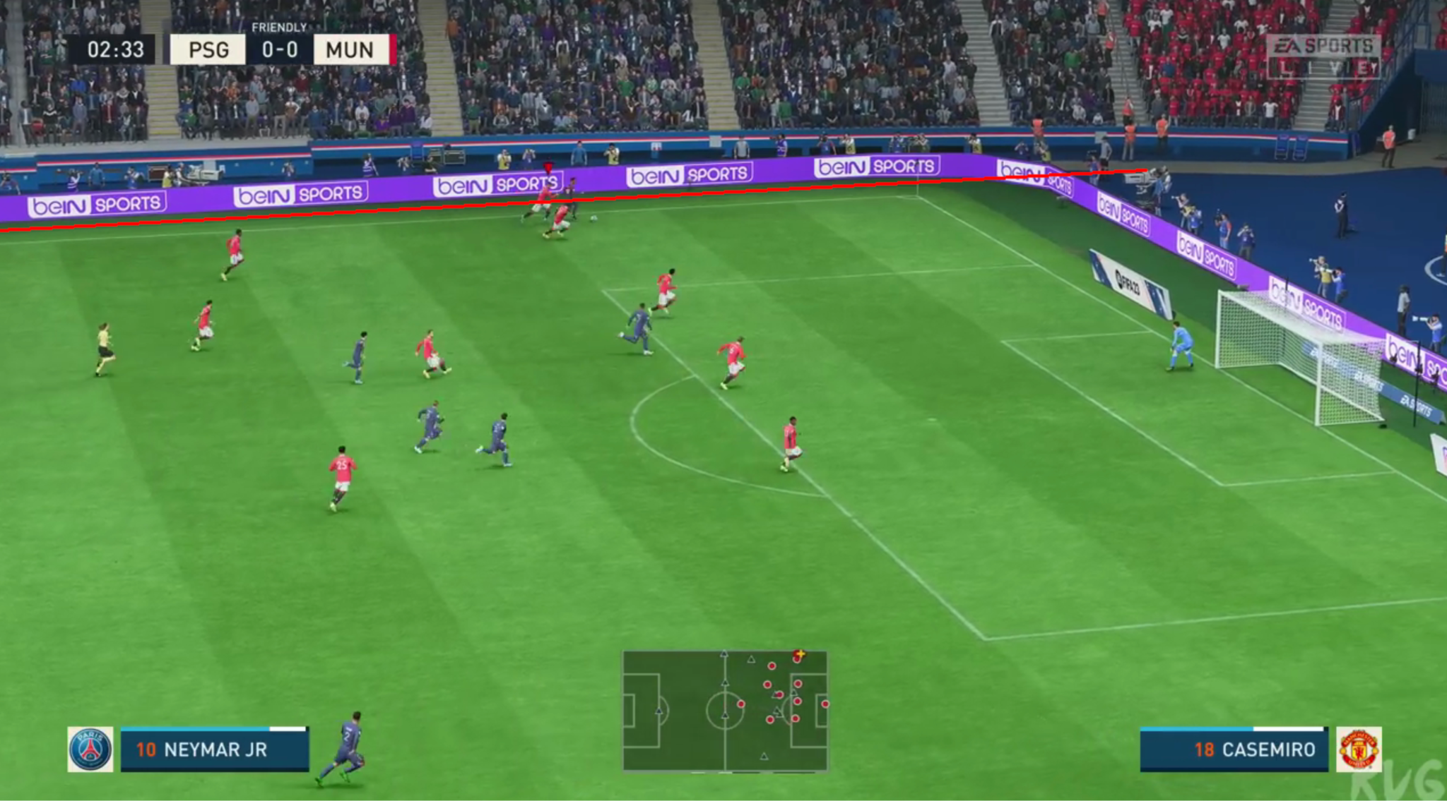
Consistent Representations with Different Camera Angles
Homography transform to project players into a non-warped frame
Improves consistency and quality
Time is dominated by object detection
60ms for dynamic homography
200-1500ms for object detection
Other Steps
Graph creation
Duplicate bounding box deletion
Real world applications
One camera needed
Notes:
An amateur team could use a single camera on a pole and a long red rope
Only a real problem if we can reduce object detection time
Other steps

Slide 8
Conclusions
Very difficult to get graph representations in an quick enough time for instant coaching feedback on personal laptops
Need to explore different computer vision models besides bounding box object detection with Yolov8
Yolov8 is very easy to work with
Image segmentation
Label more data to create better model
Python multiprocessing is missing documentation for shared memory and has its limitations
Python is used a lot for computer vision
Coach for end of game feedback
Still need performance since most frames will have no coaching insights
Notes:
Still having a performant system is better to have more feedback, since most of the frames that the system decides to try to coach on will be garbage, its important to have as many frames as possible to match against coaching points

Slide 9
Thank you!
References:
[1] https://blog.roboflow.com/detect-small-objects/#how-to-effectively-detect-small-objects
[2] https://github.com/niconielsen32/tiling-window-detection/blob/main/tiling.py
[3] https://www.digitalocean.com/community/tutorials/python-multiprocessing-example

